Slide 1
APARTMENT MAINTANENCE MANAGEMENT SYSTEM
SHREYA JOSHI
SAHANA MATH
CHANDANA DONGRE

Slide 2
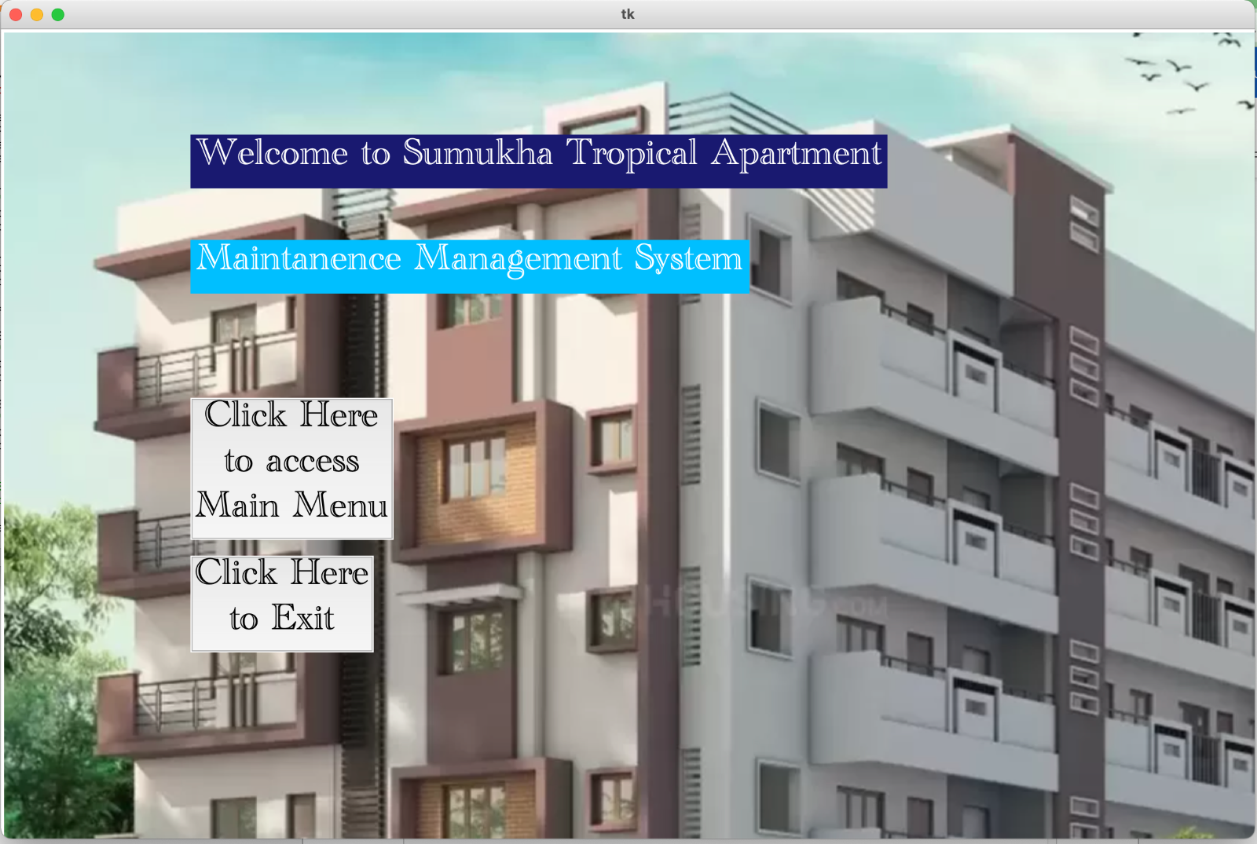
Main Page
Access Main Menu
Exit

Slide 3
Modules/Concepts Used
Graphic User Interface: Tkinter
Buttons, labels, entry box
Tkinter messagebox
Backend: File Handling with text file
Read
Write
append

Slide 4
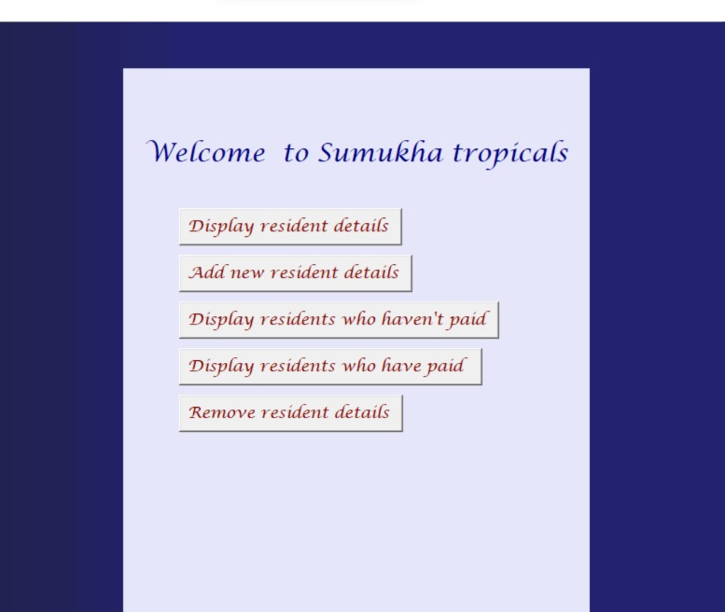
Main Menu
1. View resident details
2. Display not paid
3. Display paid
4. Add resident
5.Remove resident

Slide 5
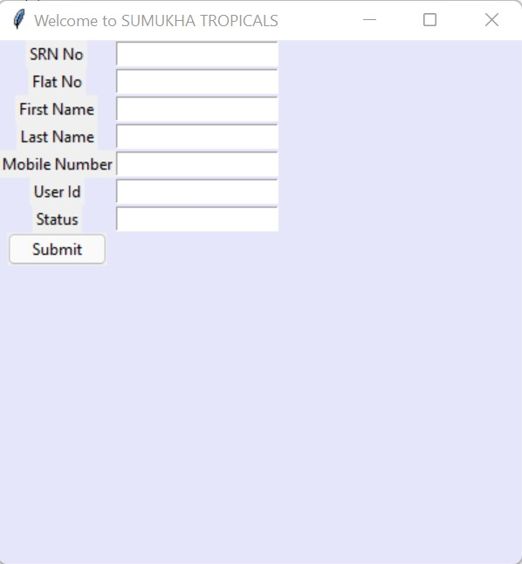
Add details

Slide 6
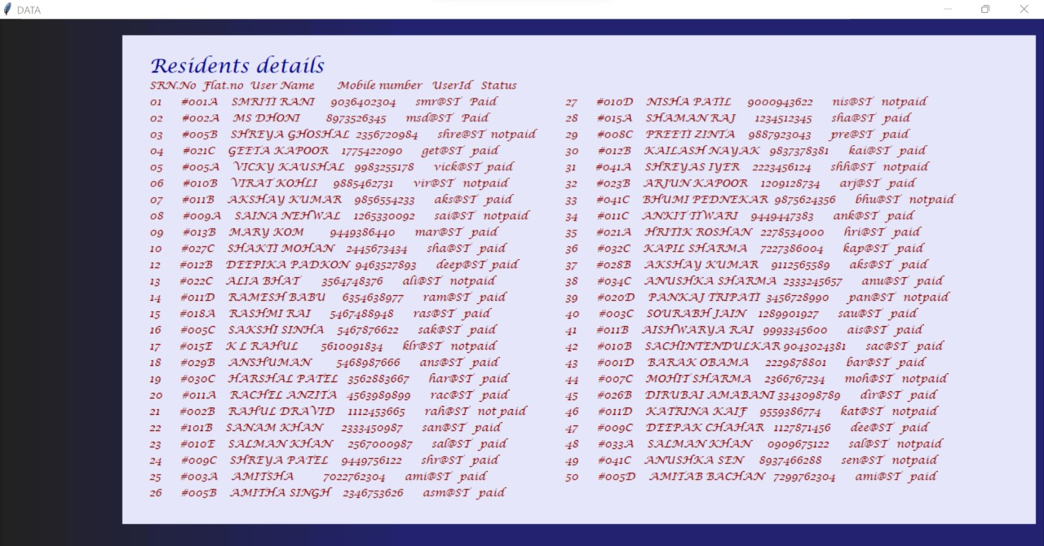
Display details

Slide 7
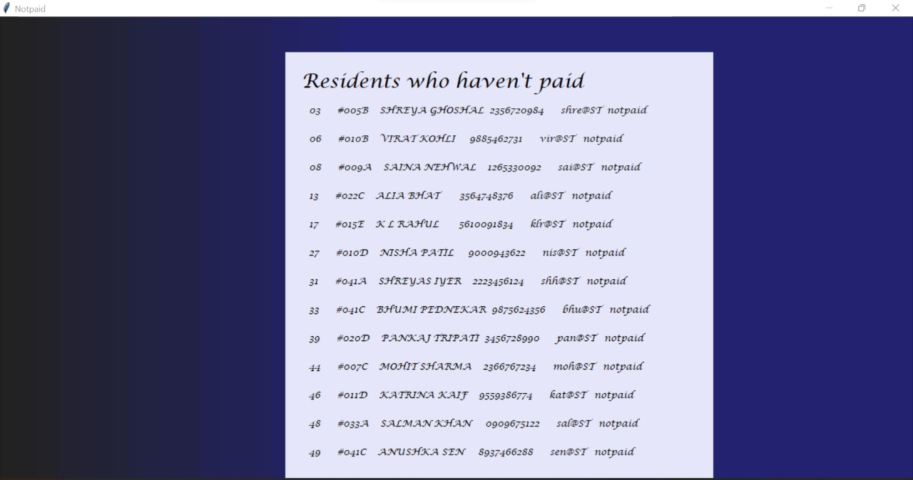
Residents who haven't paid

Slide 8
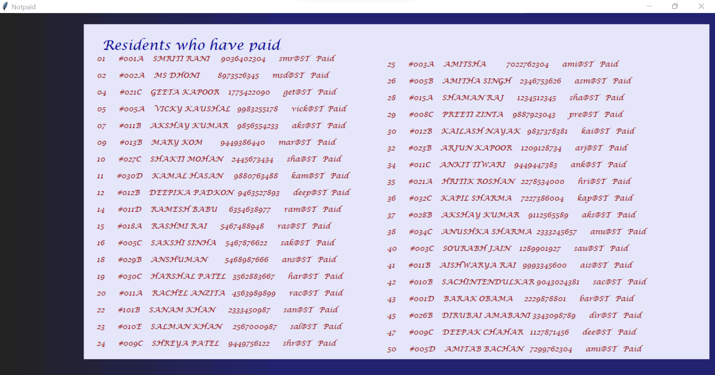
Residents who have paid

Slide 9
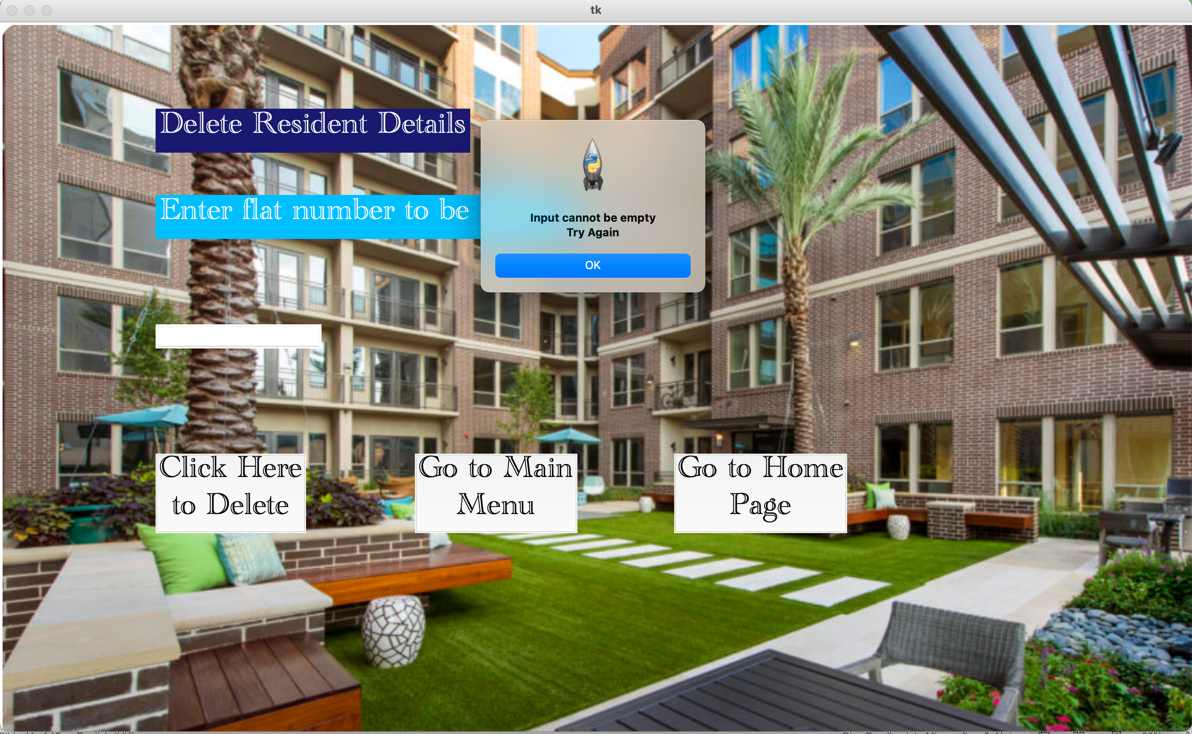
Remove Resident's record- empty input

Slide 10

Remove Resident's record- invalid input

Slide 11
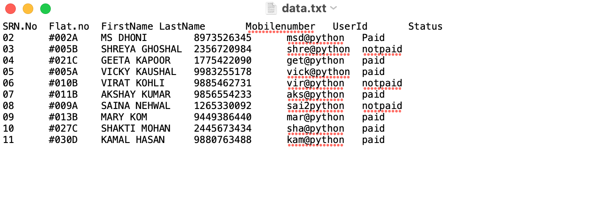
Text file before deleting

Slide 12
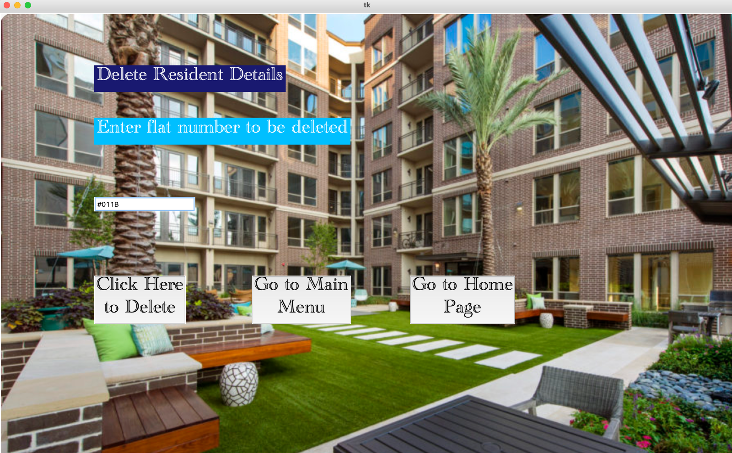
Valid input- flat #011B entered in text box

Slide 13
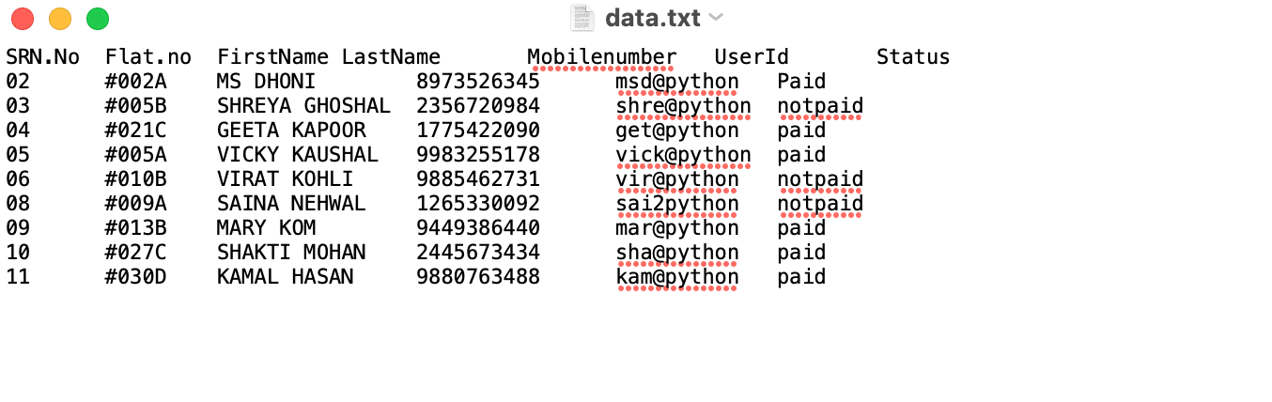
Text file after deleting- flat #011B is deleted

